Slide 1
EXPLORATORY DATA ANALYSIS
Exploratory data analysis: a 3-step process
(1) Examining the size and shape of your data
(2) Basic cleaning of your data
(3) Discovering and visualizing statistical relationships and patterns

Slide 2
EXPLORATORY DATA ANALYSIS
Exploratory data analysis: a 3-step process
(1) Examining the size and shape of your data
(2) Basic cleaning of your data
(3) Discovering and visualizing statistical relationships and patterns

Slide 3
STEP #1: CHARACTERISTICS/STRUCTURE OF DATA
DETERMINE:
What are your relevant variables?
Shape of your variables
Size (total # of elements) of your variables
Coordinates of your variables
Notes:
Tabular data – each column is a different aspect of your data (a different variable)
Gridded data – distinct variables
Shape of your variables
Tabular data – # of rows is length of the aspect of the dataset; # of rows and # of columns for dataset overall
Gridded data – number of dimensions, and size of each dimension

Slide 4
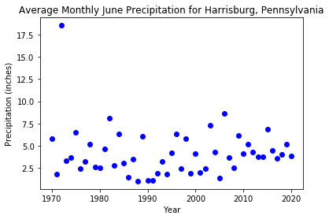
STEP #2: CLEANING DATA: OUTLIERS
Outlier: a data point that is really different than other data points – may or may not actually be a valid data point
NON-SPATIAL (AND UNIVARIATE) DATA
Visually
box-and-whiskers plot, time series, scatter plots
Quite an outlier…

Slide 5
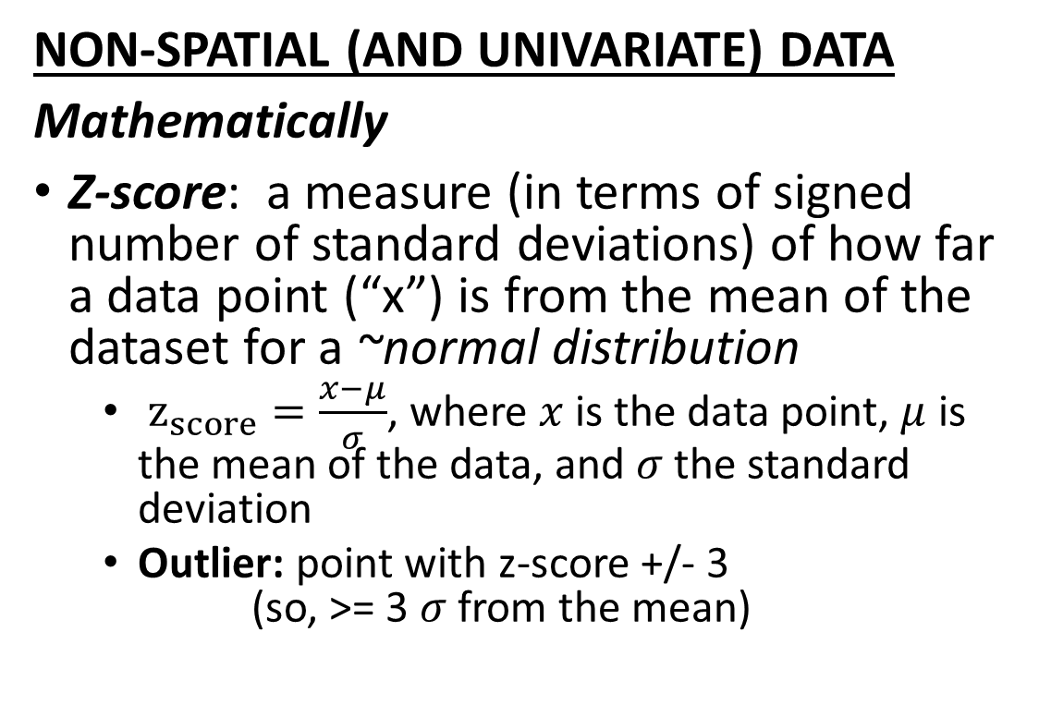
STEP #2: CLEANING DATA: OUTLIERS
NON-SPATIAL (AND UNIVARIATE) DATA
Mathematically
Z-score: a measure (in terms of signed number of standard deviations) of how far a data point (“x”) is from the mean of the dataset for a ~normal distribution
$z_{score}=\frac{x−μ}{σ}$, where $x$is the data point, $μ$ is the mean of the data, and $σ$ the standard deviation
Outlier: point with z-score +/- 3 (so, >= 3 $σ$ from the mean)
Quite an outlier…
z-score: 5.2

Slide 6
STEP #2: CLEANING DATA: OUTLIERS
NON-SPATIAL (AND UNIVARIATE) DATA
Mathematically, cont’d
Using a function of IQR: a measure based on IQR, which also estimates spread
Potential outlier: if x < Q1 – 1.5(IQR) or x > Q3 + 1.5(IQR)
Quite an outlier…
Point does not fall between -1.6 and 9.2

Slide 7
STEP #2: CLEANING DATA: OUTLIERS
What leads to outliers?
Errors in initial measurement of data (and/or the experiment that produced it)
Errors in entry or processing of data
Something actually neat and novel occurring (example: extreme event!)
Quite an outlier…
BUT hello, Tropical Storm Agnes in June 1972!

Slide 8
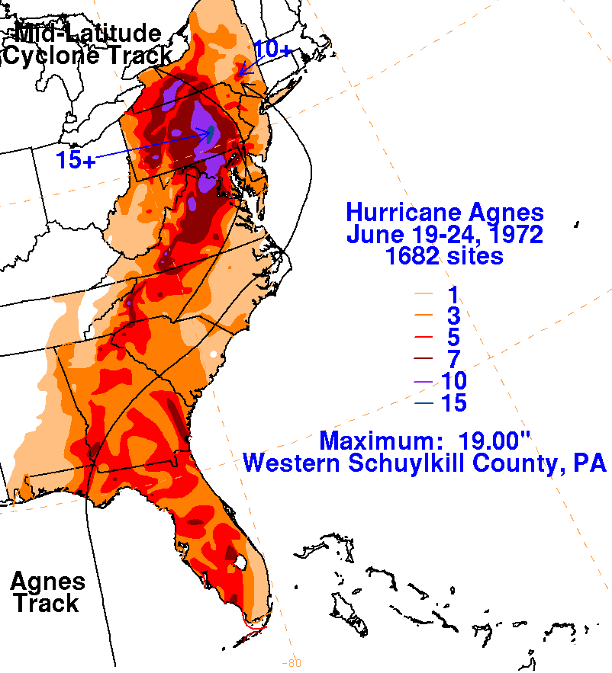
STEP #2: CLEANING DATA: OUTLIERS
What leads to outliers?
Errors in initial measurement of data (and/or the experiment that produced it)
Errors in entry or processing of data
Something actually neat and novel occurring (example: extreme event!)
Quite an outlier…
BUT hello, Tropical Storm Agnes in June 1972!
Image courtesy of the National Oceanic and Atmospheric Administration: https://www.wpc.ncep.noaa.gov/tropical/rain/agnes1972.html

Slide 9
STEP #2: CLEANING DATA: OUTLIERS
Caveat: is there a physical reason (e.g., occurrence of extreme event) there might be outlier values in your data set?
Consider: what should you do if you identify an outlier?
Delete it and associated data?
Still use it in analyses if it seems to be representing an actual (extreme) event?
Quite an outlier…
BUT hello, Tropical Storm Agnes in June 1972!

Slide 10
STEP #2: CLEANING DATA: OUTLIERS
SPATIAL (AND MULTIVARIATE) DATA
Flag locations with values that are outside of typically-understood physical bounds
Flag locations with very different values than neighboring locations
Keep in mind: physical factors that could cause these differences (e.g., altitude)
Flag locations with large increases/decreases between times at a given location
Keep in mind: physical processes that could cause these differences (e.g., with temperature data, a frontal passage, nightfall, etc)
Manually spot-check maps of your data

Slide 11
STEP #2: CLEANING DATA: NANS
What is a “NaN”? “Not a Number”: a common missing data presentation
Data is undefined or unpresentable
In Python
NaNs are always floating-point numerical values
There are functions for dropping NaNs, or filling them in with specific values
Many functions and operations will ignore NaNs – helpful!

Slide 12
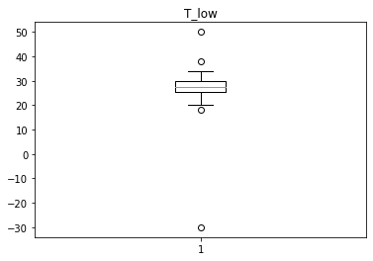
EXAMPLE CLEANING:
T_high | T_low
43 | 34
52 | 27
43 | 28
45 | 24
50 | 30
37 | 50
37 | 30
44 | 28
41 | 26
42 | 20
NaN | 28
47 | 27
52 | 38
51 | 27
29 | -30
37 | 18
High and low temperature data
Q: What data issues should be addressed?

Slide 13
EXAMPLE CLEANING:
T_high | T_low
43 | 34
52 | 27
43 | 28
45 | 24
50 | 30
37 | 50
37 | 30
44 | 28
41 | 26
42 | 20
NaN | 28
47 | 27
52 | 38
51 | 27
29 | -30
37 | 18
High and low temperature data
Q: What data issues should be addressed?
Low temperature is higher than high temperature!
NaN alert!
Suspiciously low temperature based on data in preceding and following day and when considering box-and-whisker plot!

